Slide 1
Using Technology In The Classroom

Slide 2
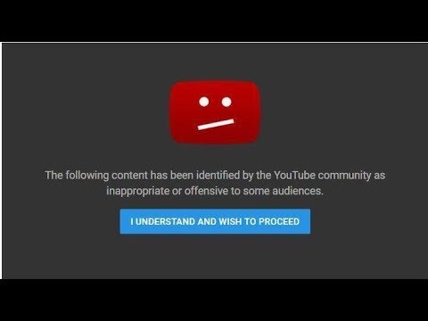
Using The TV’s
YouTube
Safeguards
Video Duration

Slide 3
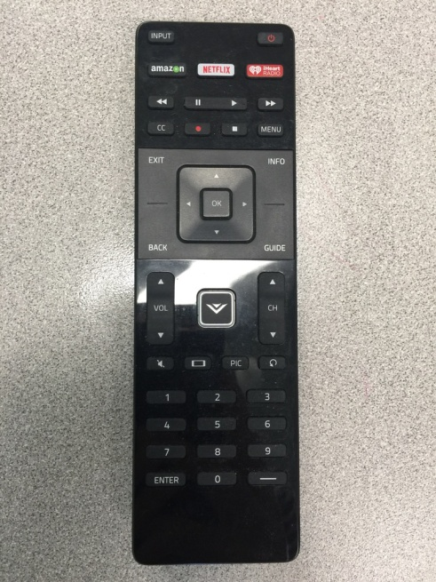
Accessing YouTube

Slide 4
Safeguards
Preview Early
Verify Accuracy
Access Video Before Kids Enter The Room. Content is dicey and it can take many minutes to pull up a video.
Just Searching “Adam & Eve” On YouTube produced a list of video displays that showed nudity, bad language and were completely off topic from the Biblical story.

Slide 5
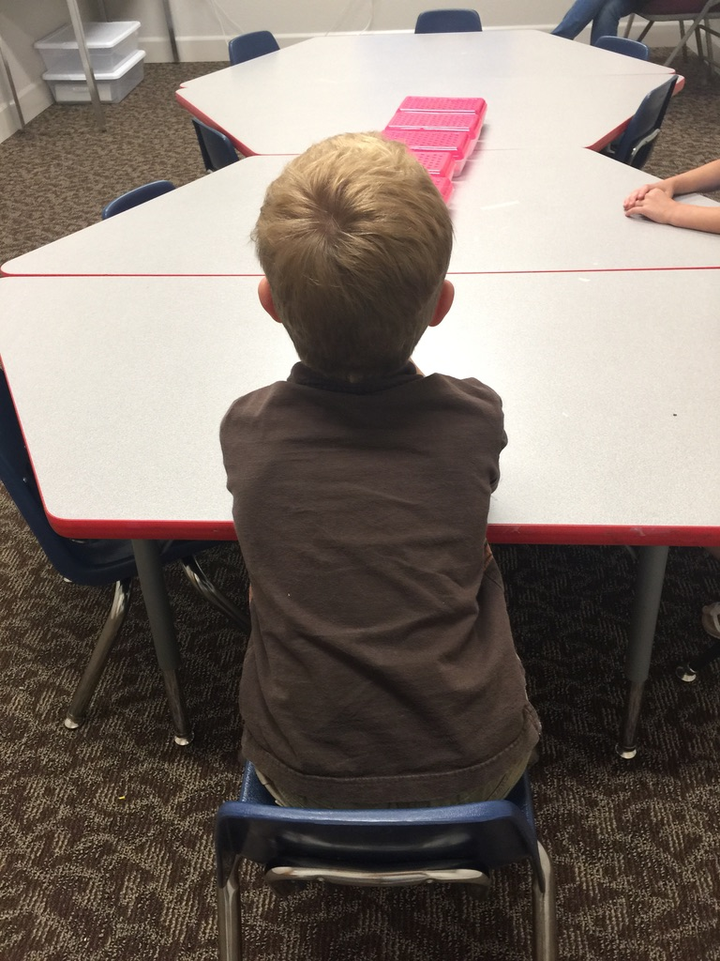
VIDEO
DURATION
Typically 2-3 Minutes—Long enough to reinforce the main point, but short enough to keep their attention.

Slide 8
How To Connect Devices
Bring Your Own Cord or Make Sure The One In The Classroom Is Compatible
ChurchOfChrist5.0
1John3:16
www.folsomchurch.com

Slide 9
Using Power Point
The “I’ll Get Back To You” Questions
Memory Work: Sentence Summaries
Enhancing The Lesson

Slide 10
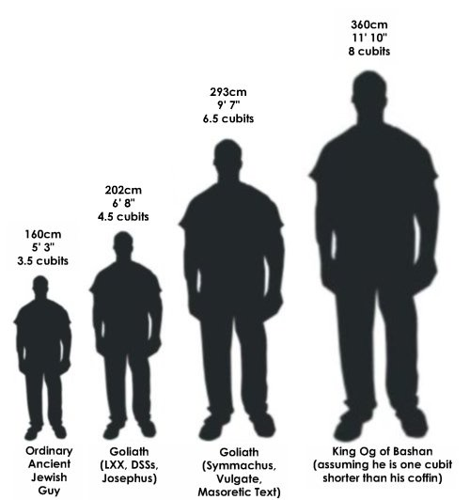
“I’ll Get Back To You On That”
“How Big Was Goliath?”
1 Samuel 17:4 A champion named Goliath, who was from Gath, came out of the Philistine camp. His height was six cubits and a span
“Do Giants Exist Today?”

Slide 11
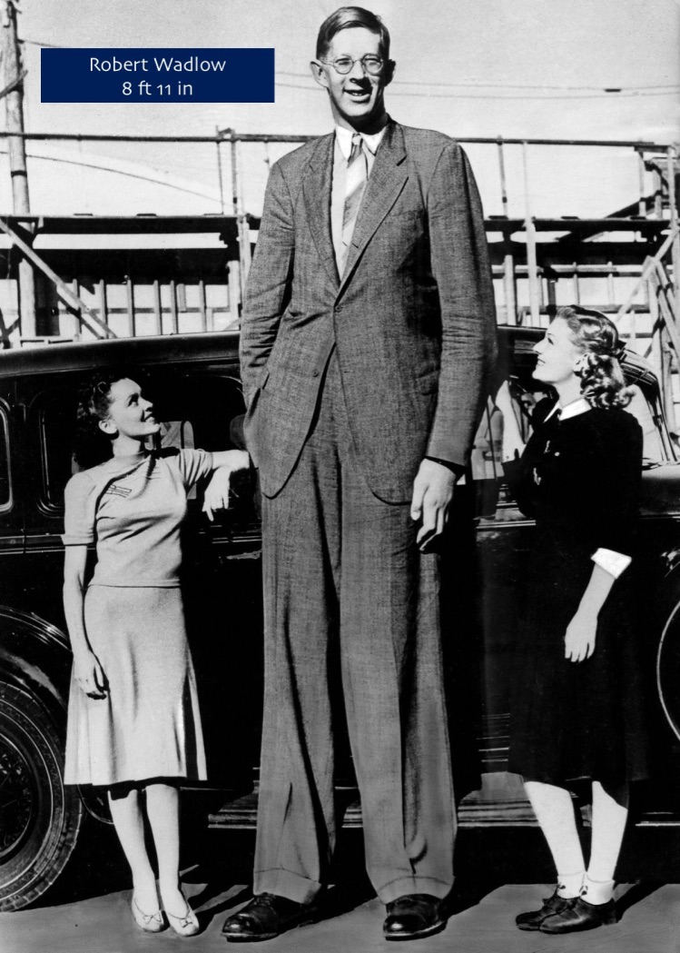
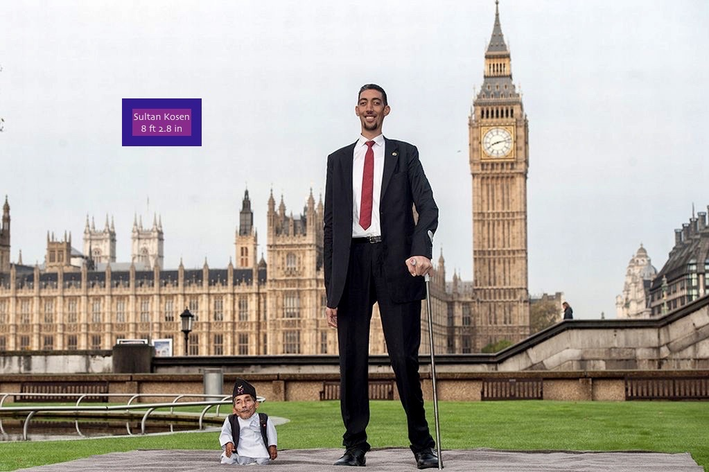
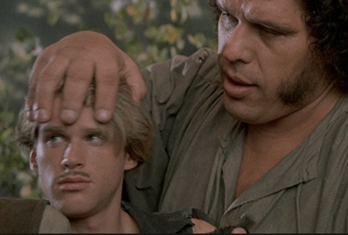
Bring It Back To David… 1 Samuel 17:37 “The Lord who rescued me from the paw of the lion and the paw of the bear will rescue me from the hand of this Philistine.”
7 ft 4 in

Slide 12
Using Power Point With Sentence Summaries
Flash Cards: Spaced Repetition
Studies have found that it's more effective to review a whole stack of cards in one sitting, using spaced repetition, than to study a couple here and there.
Spaced repetition is one of the most effective ways of using flashcards. This is when you review your cards at specific, increasing intervals. Spaced repetition works because it activates your long-term memory, while leaving small breaks in-between studying uses your short-term memory.
(Nate Kornell, UCLA Psychology Dept.)

Slide 13
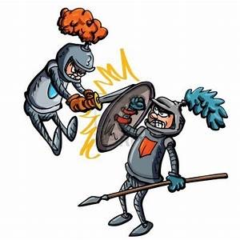
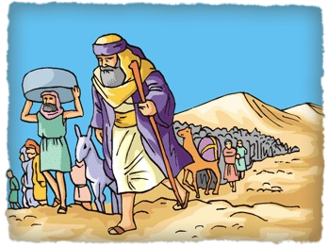
Sentence Summaries
NUMBERS
A census of fighting men, the guiding cloud & wilderness wanderings.
Kids Use Notecards to Make Their Own—Part of That Kinesthetic Learning!

Slide 14
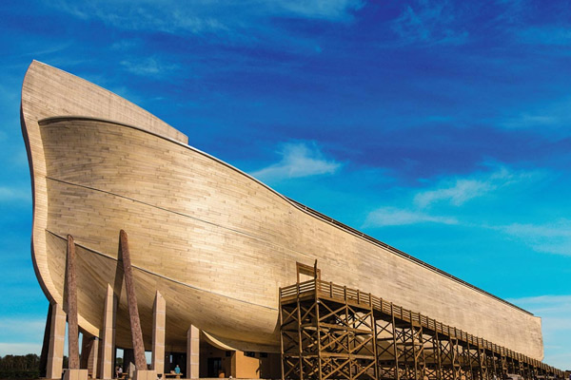
ENHANCING THE LESSON
https://arkencounter.com
God Is Trustworthy
Noah: Trust & Obey

Slide 15
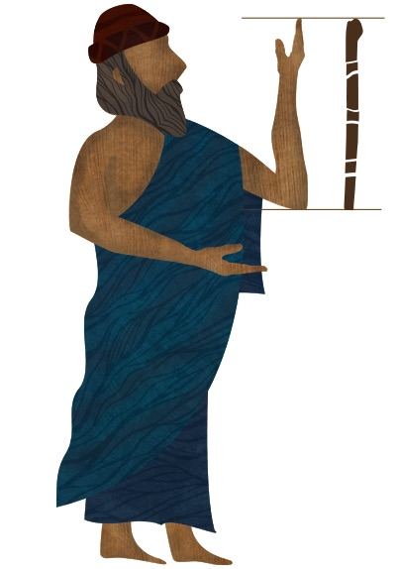
Genesis 6
15 This is how you are to build it: The ark is to be three hundred cubits long, fifty cubits wide and thirty cubits high. 16 Make a roof for it, leaving below the roof an opening one cubit high all around. Put a door in the side of the ark and make lower, middle and upper decks.
WHAT IS A CUBIT?
A cubit is an ancient measurement of length based on the distance from the elbow to the tip of the longest finger.
184.2 ft
184.2 ft
184.2 ft
A Cubit Measures Around 18 inches. So, Noah’s ark was longer than 3 Nasa Rockets lined up, or…

Slide 16
…one and a half football fields.

Slide 17
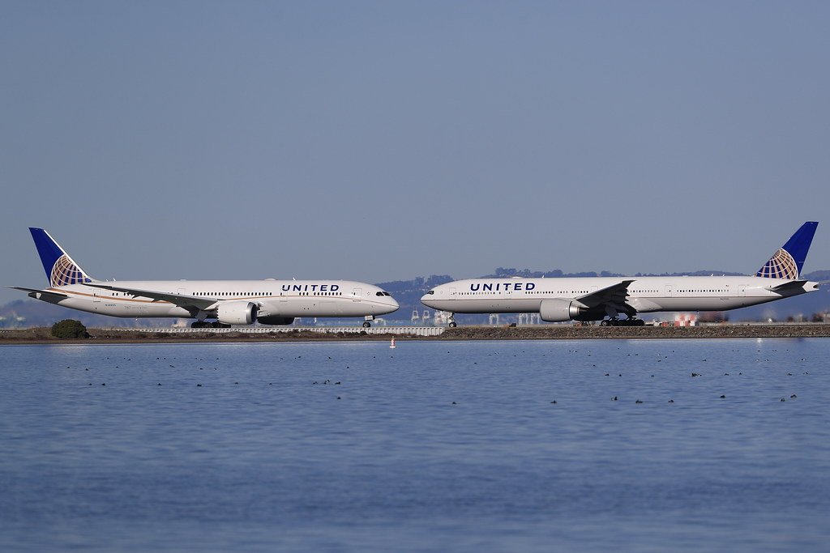
Or…
Nearly the length of TWO Boeing 777 Airplanes
Seats up to 396 passengers, & its body (not counting wing span) is more narrow than the ark.

Slide 18
Or…
The Ark had the same storage capacity as about 450 standard semi-trailers. A standard livestock trailer holds about 250 sheep, so the Ark had the capacity to hold at least 120,000 sheep.

Slide 19
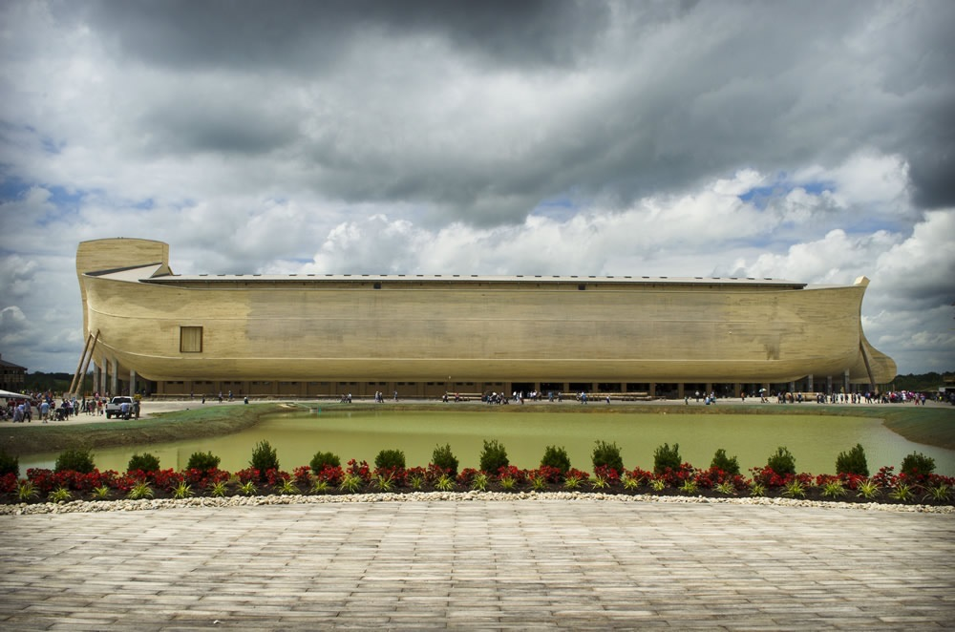

Slide 20
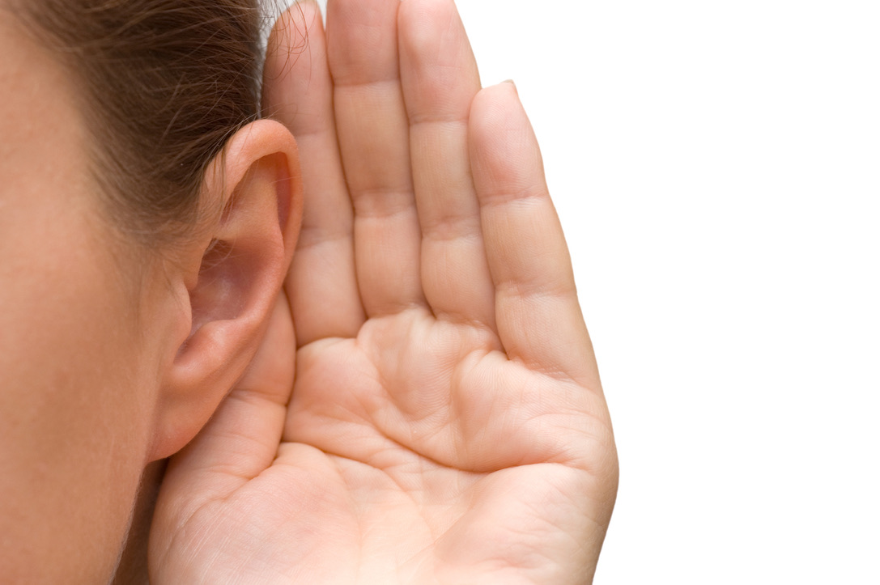
AUDIO BIBLE
SOME PASSAGES ARE LOOOOOONG….
Enabling voice audio on a smart phone, laptop or iPad can be a great way to listen to the passage in its entirety in a more timely manner.
It maintains fluidity during lengthy passages, and readers have the option of following along in their bibles.
BIBLE GATEWAY
Language and hearing are interconnected to the visual. It’s our mind’s eye.

